Slide 1



KONGU ENGINEEERING COLLEGE
Perundurai,Erode-638 060
DEPARTMENT OF COMPUTER APPLICATIONS
1
SYMPOSIUM EVENT MANAGEMENT SYSTEM
GUIDED BY:
Dr. M. PYINGKODI MCA.,M.Phil,PhD
TEAM NO:21
Team Members:
KEERTHANA R(24MCR056)
LIPIKA S (24MCR060)
24-DEC-2024

Slide 2
AGENDA
2
Objective
Existing System
Proposed System
System Requirements
Data Flow Diagram
Module Description
Class Diagram
Screenshots
Future Enhancement
Conclusion
24-DEC-2024

Slide 3
Objective
3
The purpose Symposium Event Management System is designed to streamline the management of college events.
This platform serves as an all-in-one solution for managing events within a college, allowing both admins and students to access, share, and interact with event information easily.
Admins have the ability to securely log in and add, update, or delete events.
Students are able to register as new users, log in to the system, and view the events posted by the admin.
24-DEC-2024

Slide 4
4
Existing System
Drawbacks
Students can’t notified about the upcoming events.
Admins can only update the event details manually , it leads to more time.
If not properly secured, user data like login information and event details can be vulnerable to unauthorized access
24-DEC-2024

Slide 5
Proposed System
5
Advantages
Students can easily register, log in, view, and search events.
Admins can quickly add, update, and manage events, reducing manual effort .
Students can notified about upcoming events easily.
It has strong security.
Time efficiency.
24-DEC-2024

Slide 6
System Requirements
6
Operating System : Windows 11
Frontend : React.js
Backend : Node.js
Database : Mango DB
Tools : Visual Studio
24-DEC-2024

Slide 7
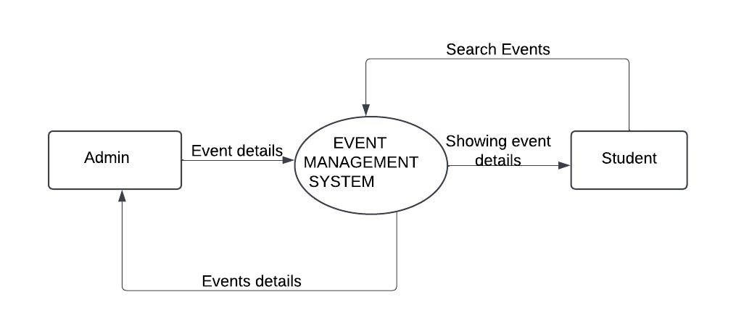
Dataflow Diagram
7
Dataflow Diagram Level 0
24-DEC-2024

Slide 8
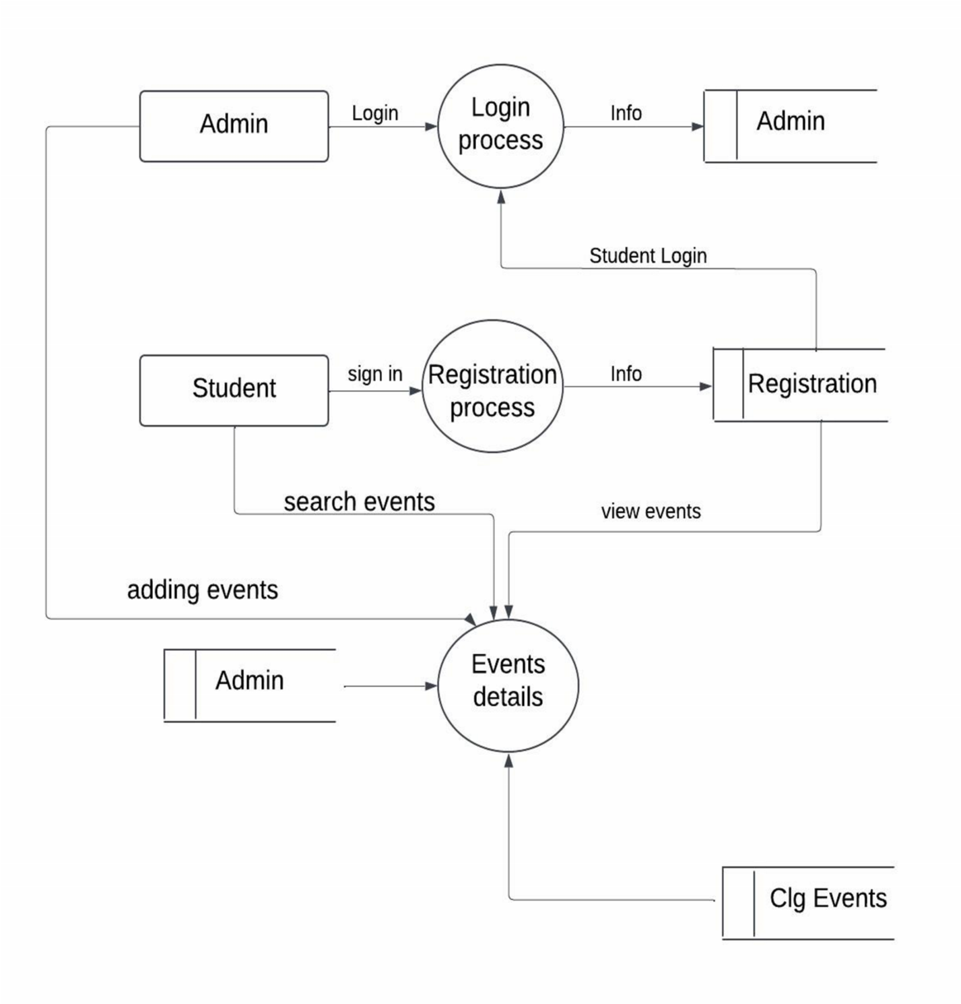
8
Dataflow Diagram Level 1
24-DEC-2024

Slide 9
Module Description
9
ADMIN MODULE
The Admin Module is like the control center for Event management for college.
It's a place where easily see all the upcoming events and important details.
These details of each event's (Read), make changes to existing events (Update), add new events (Insert), and even remove events if needed (Delete).
This module makes it super easy for event management for college to stay organized.
24-DEC-2024

Slide 10
10
STUDENT MODULE
The Student Module is where students can see or view the upcoming events and colleges and which department it is.
The students can search their events in the search bar it will list down the upcoming events in the student home page.
There will be a link the students can clicking by the link they can view the college websites.
24-DEC-2024

Slide 11
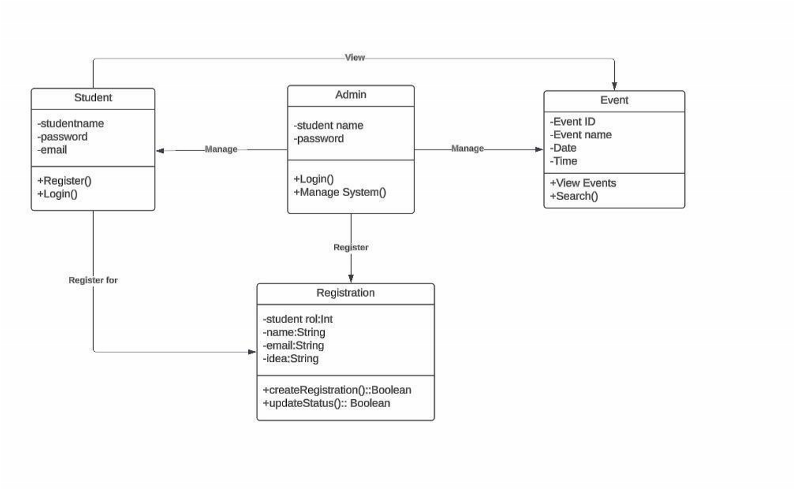
11
Class Diagram
24-DEC-2024

Slide 12
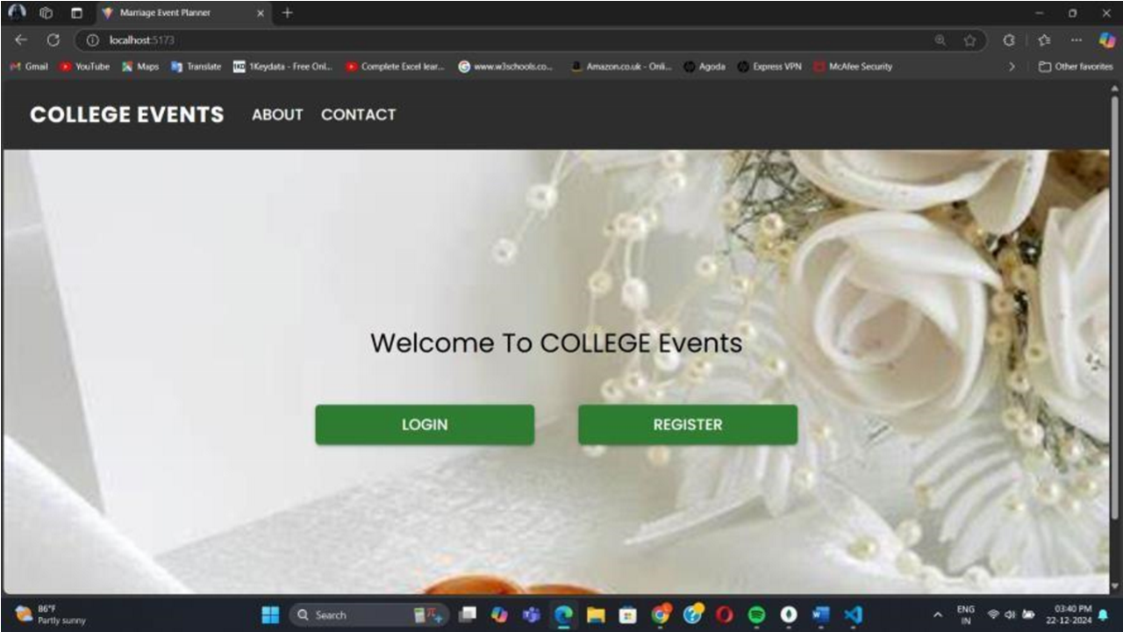
12
Screenshots
Figure.1 Home page
24-DEC-2024

Slide 13
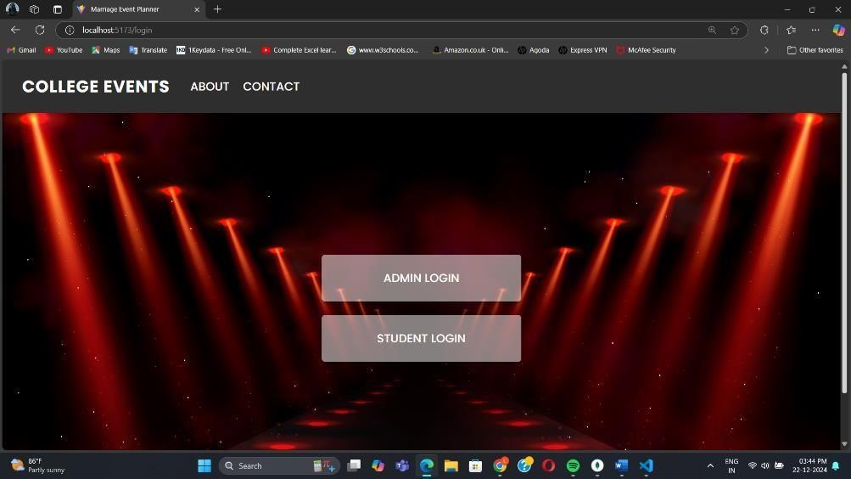
13
Figure.2 Login page
24-DEC-2024

Slide 14
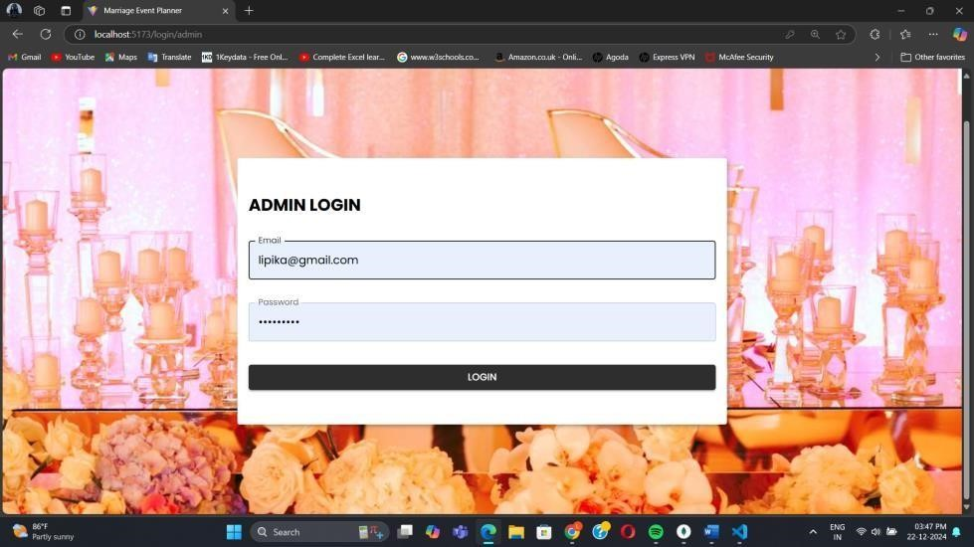
14
Figure.3 Admin Login page
24-DEC-2024

Slide 15
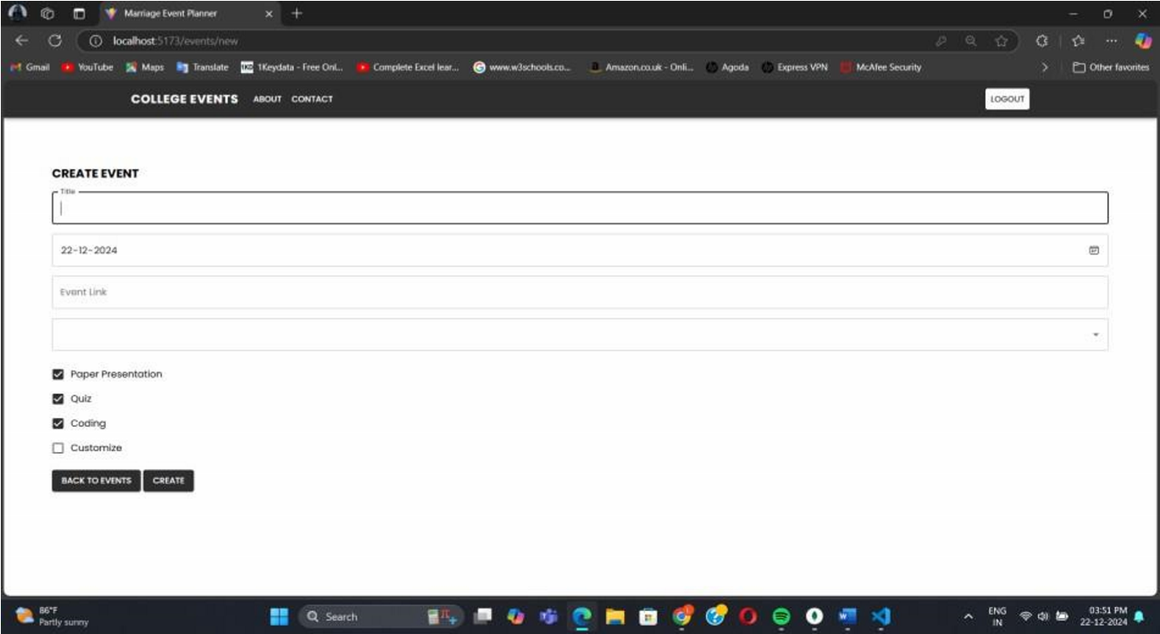
15
Figure.3.1 Admin page(Manage Page)
24-DEC-2024

Slide 16
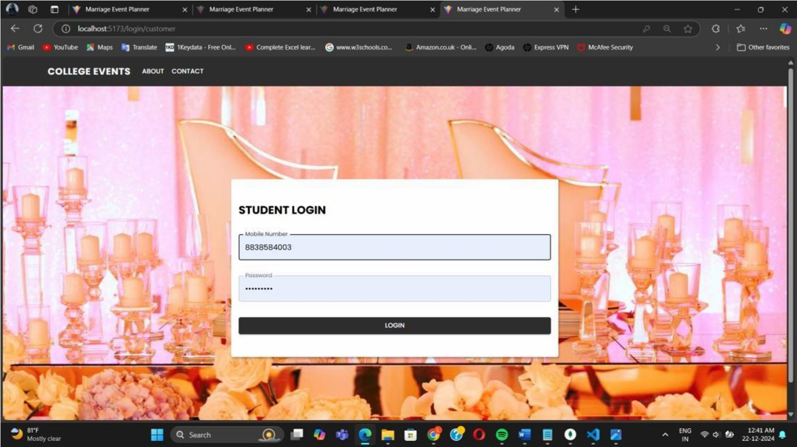
16
Figure.4 Student Login page
24-DEC-2024

Slide 17
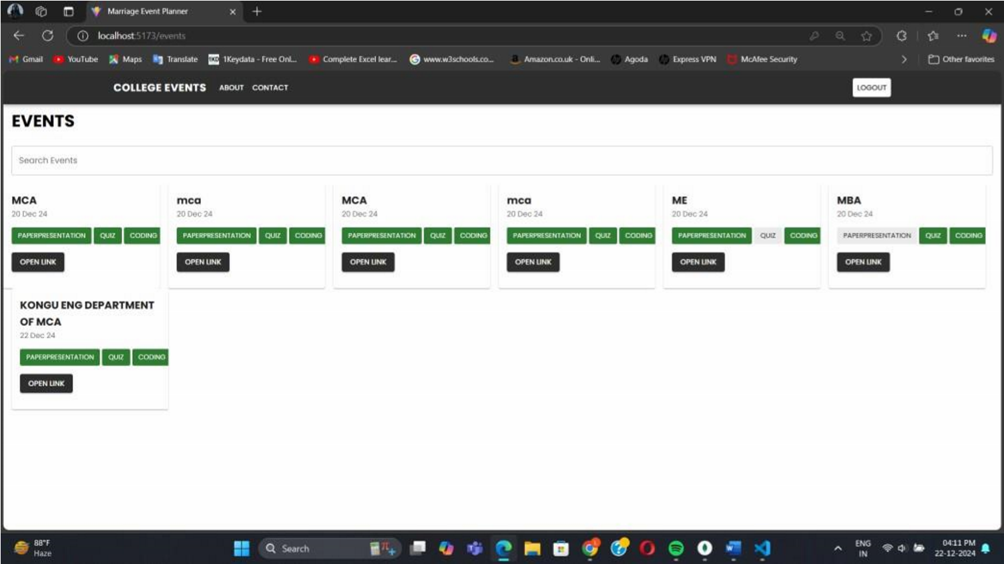
17
Figure.4.1 Student event view page
24-DEC-2024

Slide 18
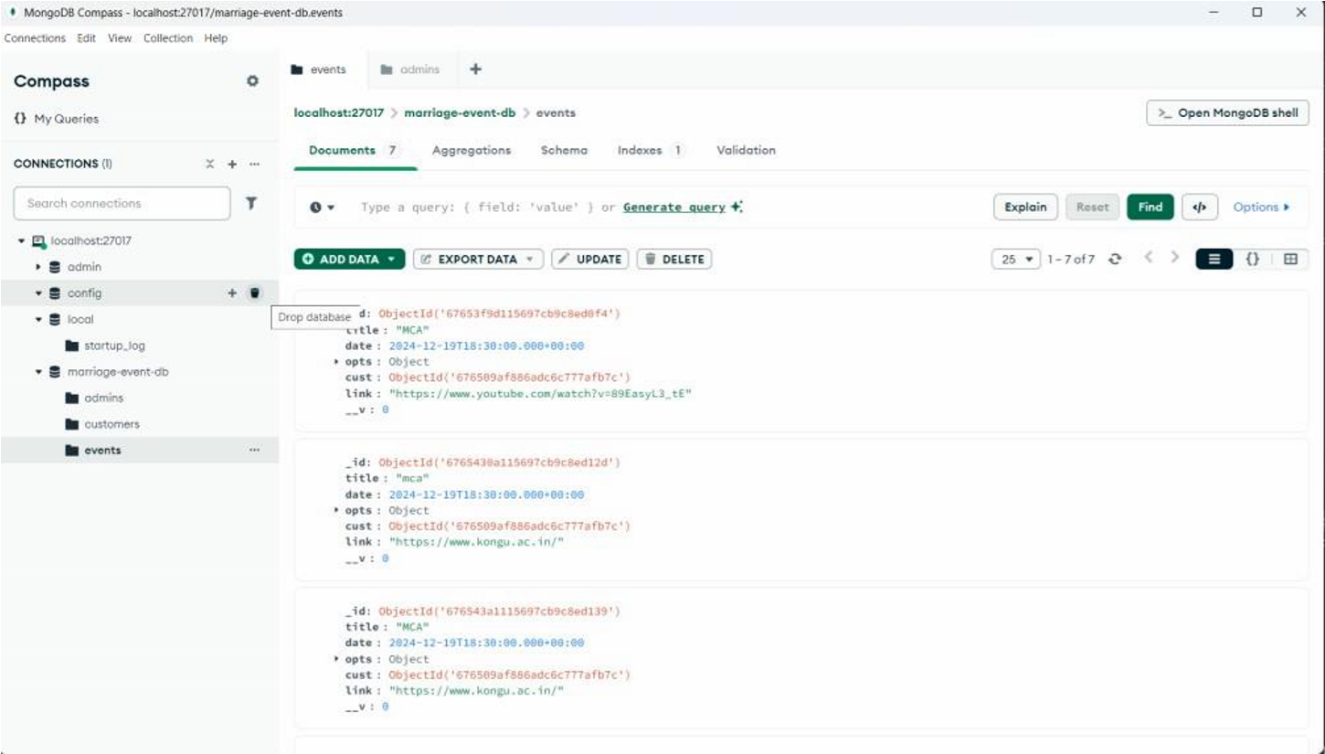
18
Figure.5 Data store in MangoDB
24-DEC-2024

Slide 19
19
Future Enhancement
In the future, the event management system can be enhanced with additional features to make it even more useful and efficient.
Features like a feedback system can be added so students can share their opinions about events, helping admins improve future events.
Integration with social media platforms can allow students to share event details and updates easily.
24-DEC-2024

Slide 20
20
Conclusion
In conclusion, the proposed college event management system is an advanced and efficient platform aimed at improving the process of event management for both admins and students.
It allows admins to securely log in, add, update, and delete events such as paper presentations, workshops, and seminars, ensuring all event details are well-organized and stored securely in a database.
Students can register, log in, view upcoming events, and use a search bar to easily find specific events.
24-DEC-2024

Slide 21

21
24-DEC-2024

